Slide 1


………………………………………….. Build your Dreams – Car App with Apex Progressive Web App Feature On Oracle Cloud Free-Tier Juni 2023 …………………………………………..

Slide 2


Tom Lieber
https://twitter.com/oraclexpert
https://www.linkedin.com/in/tom-lieber-50ab4929/
https://yaitcon.hashnode.dev https://sphinx.at
https://sphinx.at/blog
Yet another IT Consultant
Experience:
Oracle since 1996 7.3.4 - 23c
Developer, DBA
APEX > 5
BI-Tools: Power BI
Qliksense
Exasol since 2020
Oracle Cloud since 2018
Using Oracle Free Tier
for NGO and other projects like this..
Ing. Thomas Lieber
E thomas.lieber@sphinx.at
M 0664/5183529
T +43 1 599 31-0
……………………….
sphinx
Aspernbrückengasse 2
1020 Wien
……………………….
www.sphinx.at
2

Slide 3
1
Reasons for this Project
2
Architecture
3
The APP
4
Pains und Learnings
5
The best ressources to start with Oracle Cloud Free Tier

Slide 4
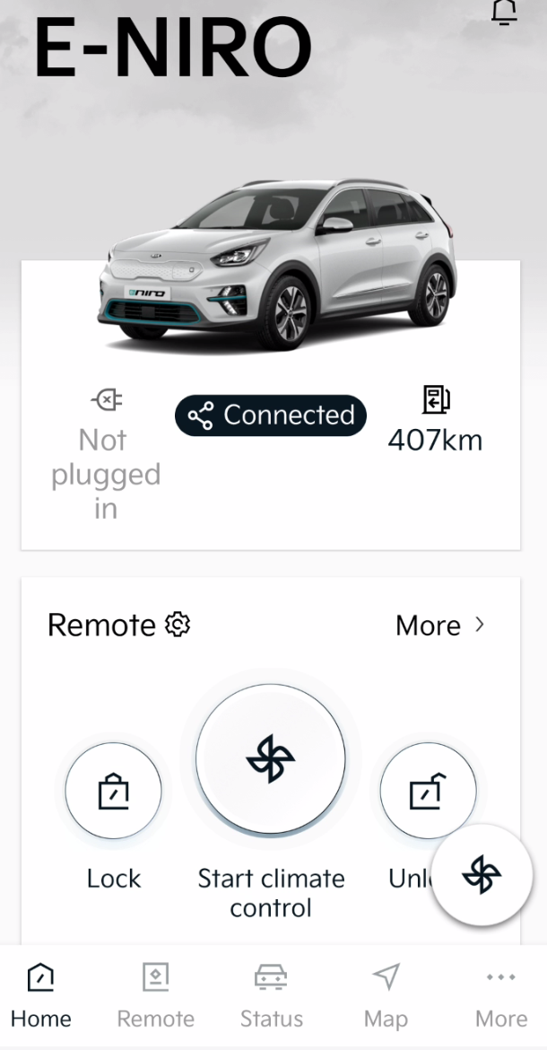
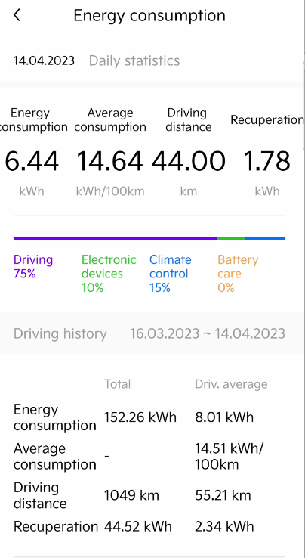
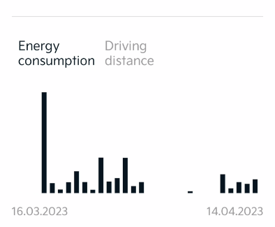
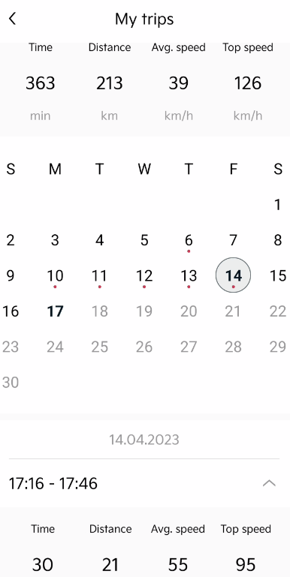
Ausgangslage Statistiken der Herstellerapp
Starte APP
4 Clicks um Verbräuche aggregiert
abzulesen
Aussagekräftigste
Statistiken
3 Clicks um Tageweise zahlen
abzulesen

Slide 5
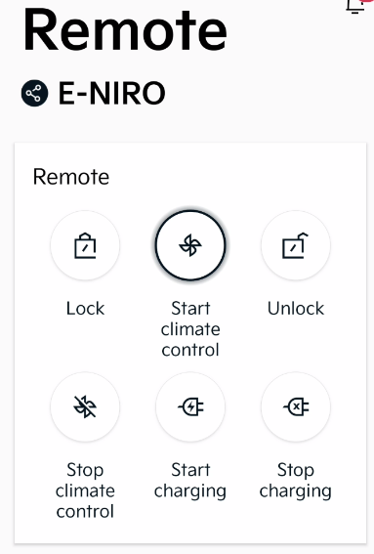
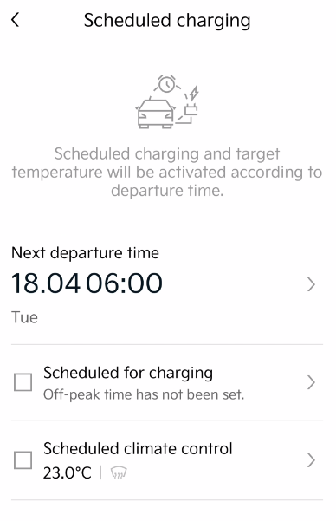
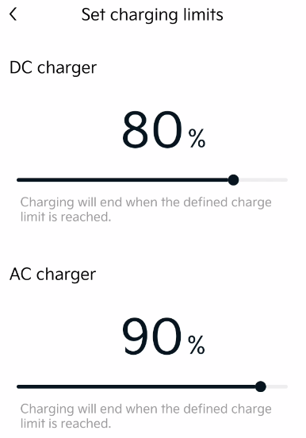
Ausgangslage Fernbedienung
Starte APP
3 Clicks um Ladelimits zu setzen
Nur wenn angesteckt!

Slide 6
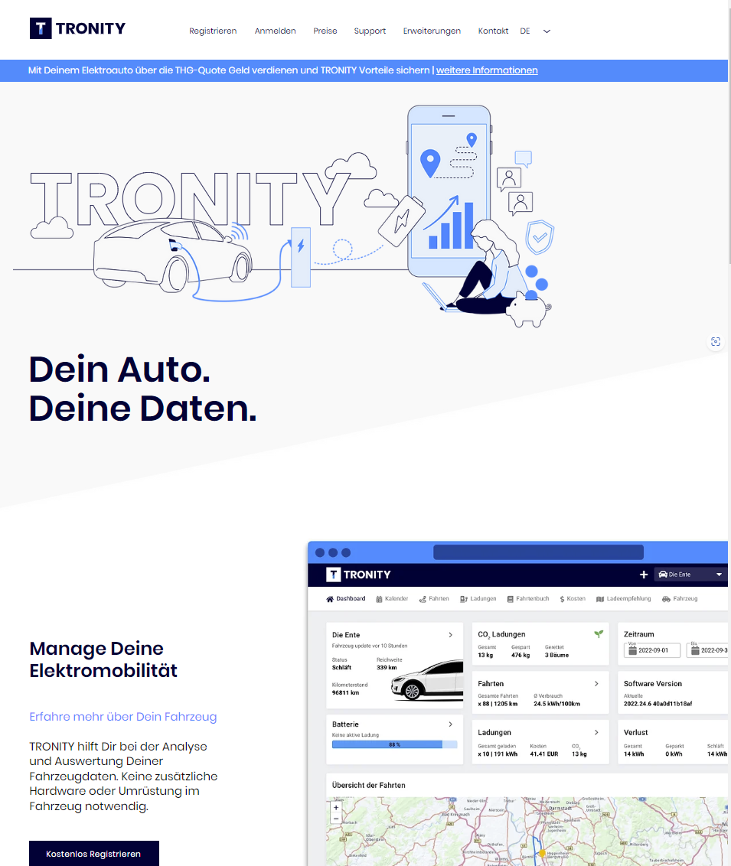
Alternativen
Ende 2022 war Tronity noch sehr rudimentär, mittlerweile
wurde diese App weiterentwickelt und ist für mehrere
Hersteller verfügbar. Sie bietet aber keine Fernsteuerfunktionen.

Slide 7
2
Architecture

Slide 8
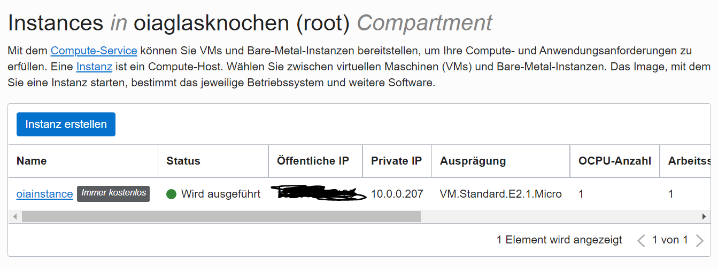
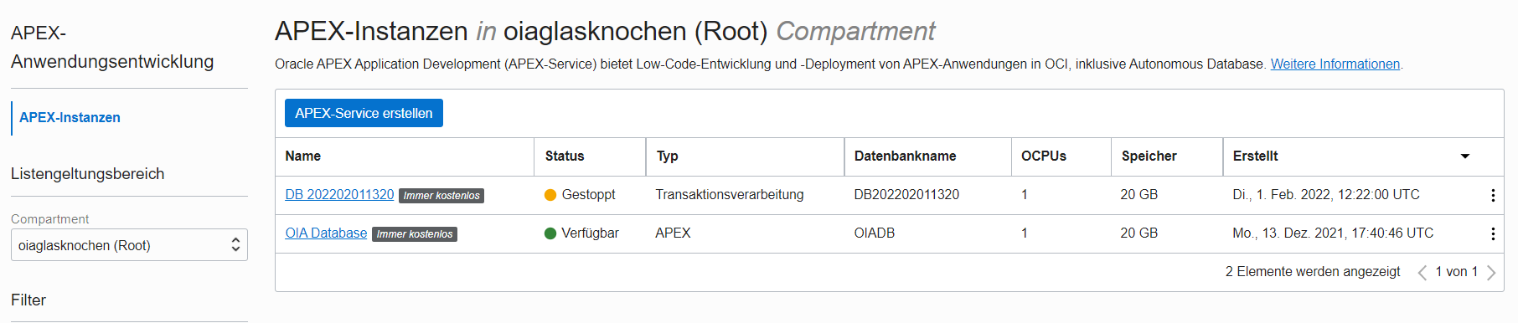
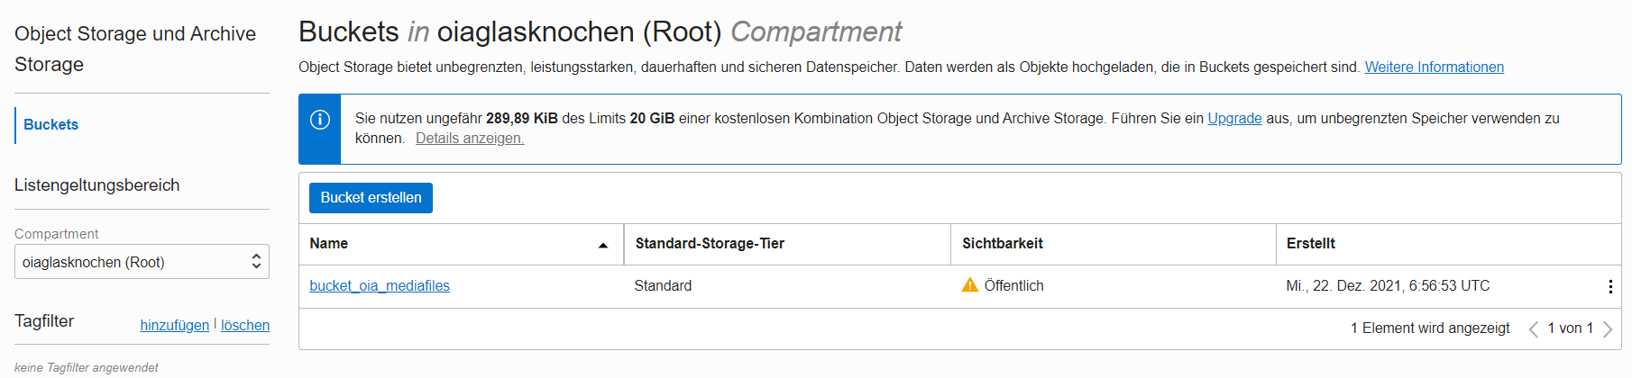
A
Oracle Cloud Infrastructure Free-Tier 21c
Eine kleine Linux VM
(1 OCPU,1 GB Memory,0.5Gbit netz)
a) Domainweiterleitung auf App
b) Certificatehandling (https)
2) APEX oder Datenbank Instance
für die Applikationsentwicklung
a) Apex Instance (nicht zu empfehlen)
b) Oracle DB auch mit APEX
3) Object Storage
Für Medien und sonstige Files
Backup => datapump it
Ergibt: Storage in Summe 60 GB Linux Boot Volumn 47 GB
Schafft bis zu 50 active Sessions

Slide 9
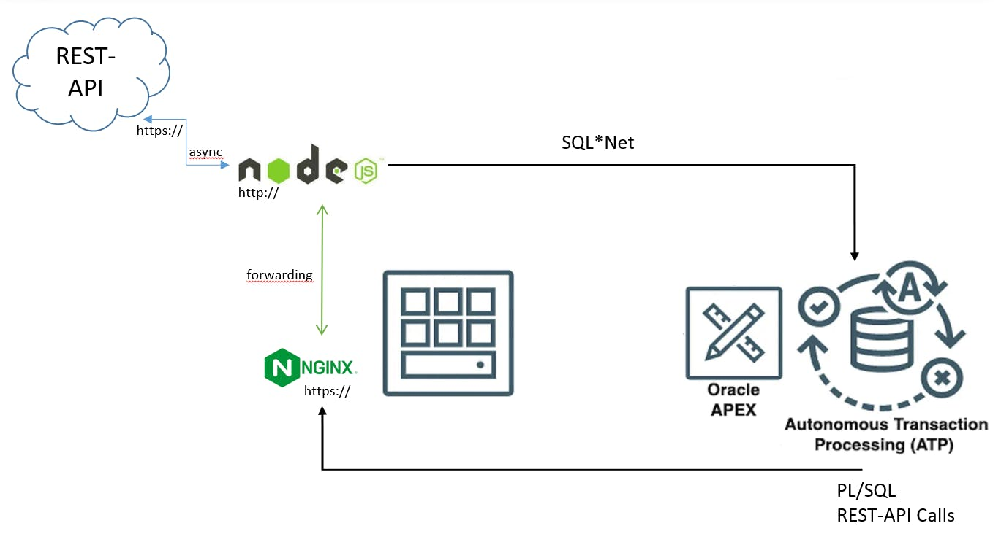

B
Cloud to Car

Slide 10
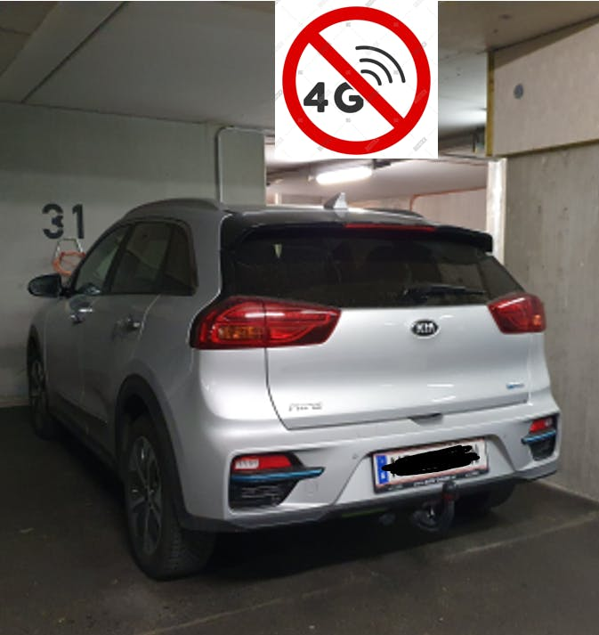
B
Cloud to Car – nicht immer möglich!

Slide 11
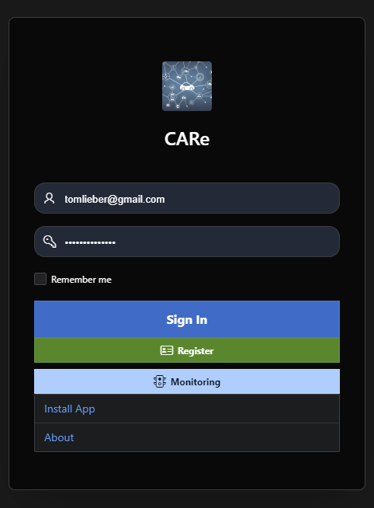
3
Wordpress Theme vs. APEX Universal Theme
The APP
Oracle APEX PWA
Oracle Linux
NGINX Certificates Routing
Oracle
Scheduler
VPD
JSON_TABLE
Oracle Linux
Node.js Bluelinky
CarConnection

Slide 12
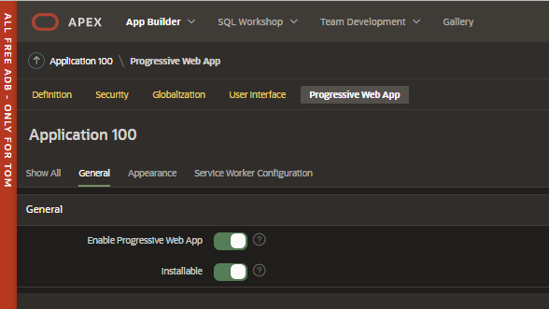
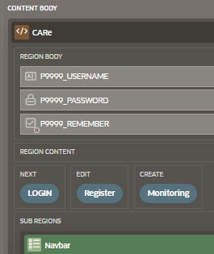
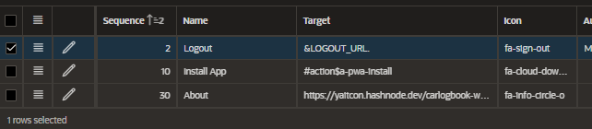
3
Wordpress Theme vs. APEX Universal Theme
Progressive Web App – im App Builder
Login Page:

Slide 13
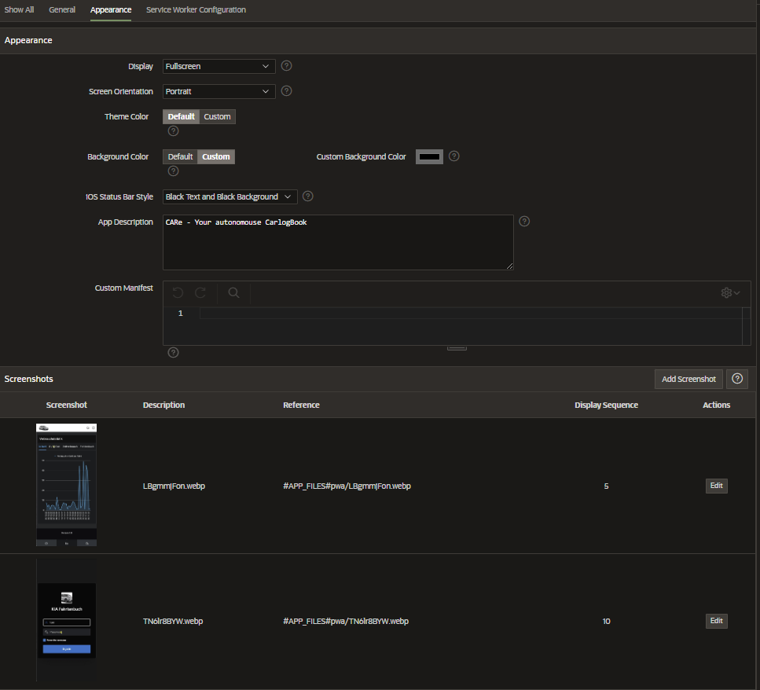
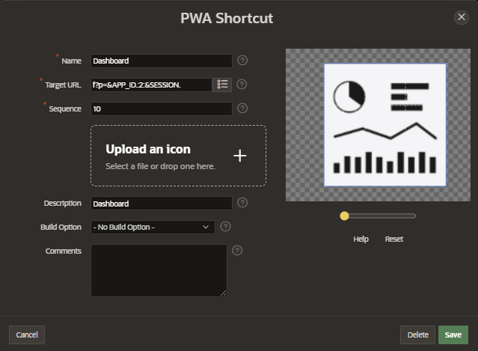
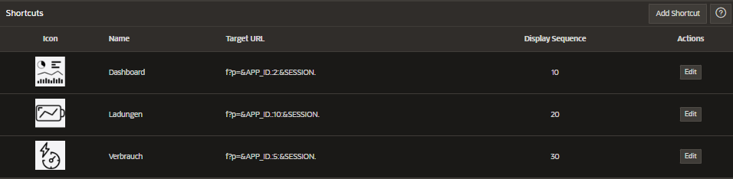
3
Wordpress Theme vs. APEX Universal Theme
Progressive Web App – im App Builder

Slide 14
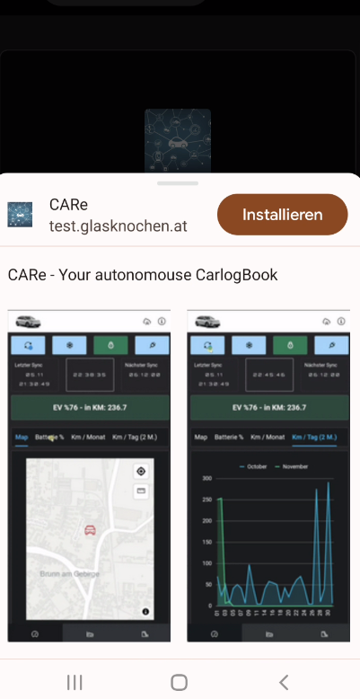
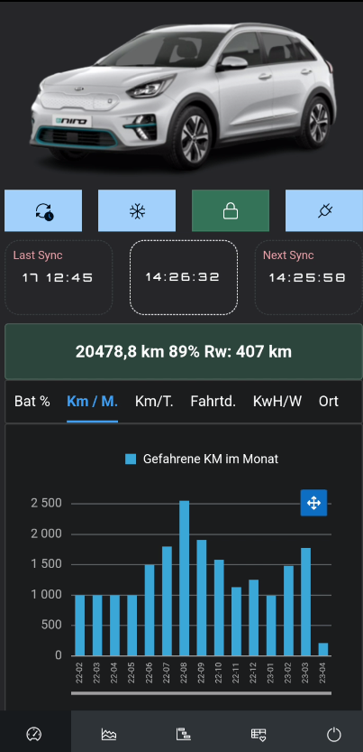
3
Wordpress Theme vs. APEX Universal Theme
Progressive Web App - Installation

Slide 15
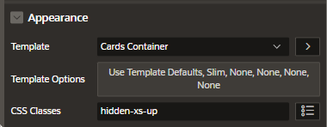
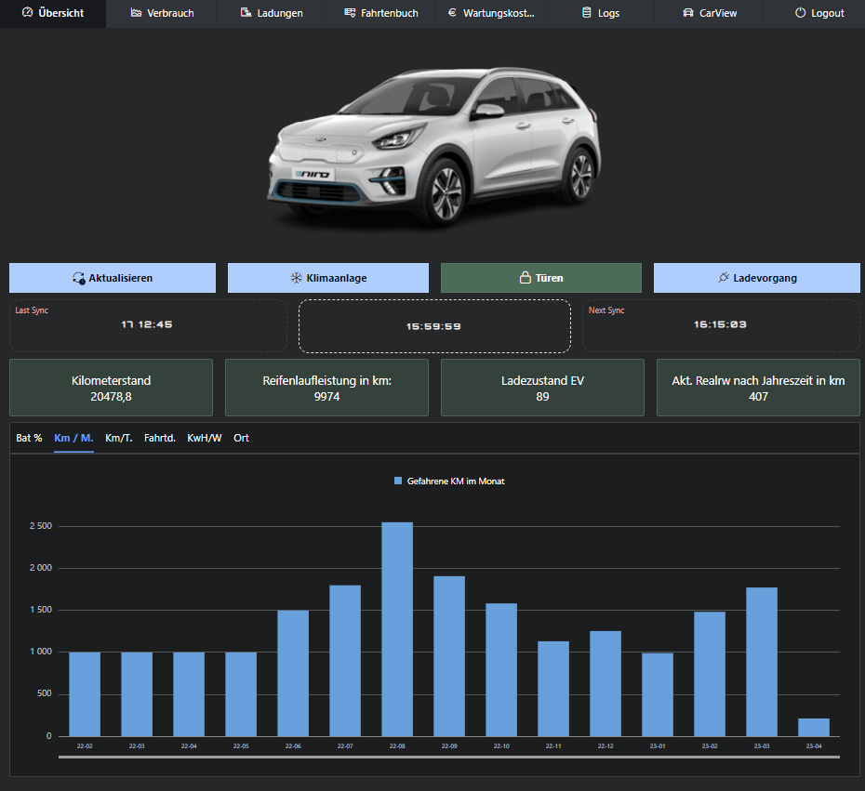
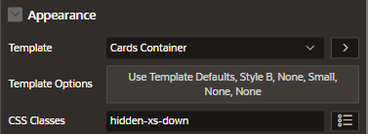
3
Wordpress Theme vs. APEX Universal Theme
Desktop Layout vs. Mobile Layout

Slide 16
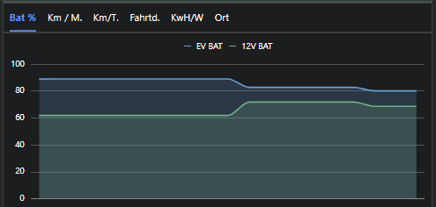
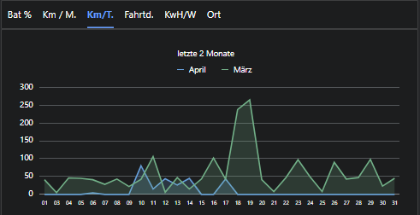
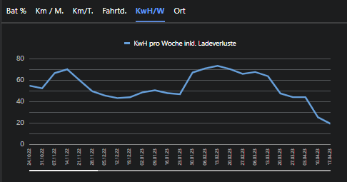
3
Wordpress Theme vs. APEX Universal Theme
Statistiken

Slide 17
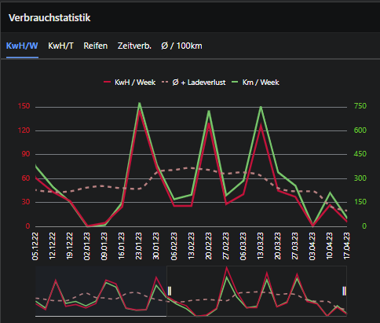
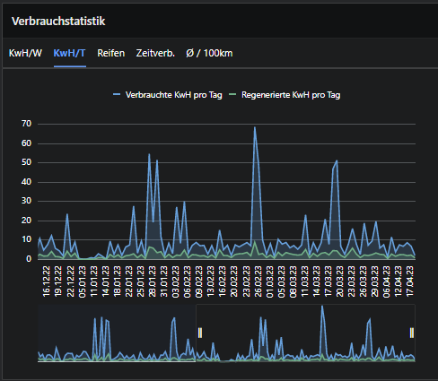
3
Wordpress Theme vs. APEX Universal Theme
Statistiken

Slide 18
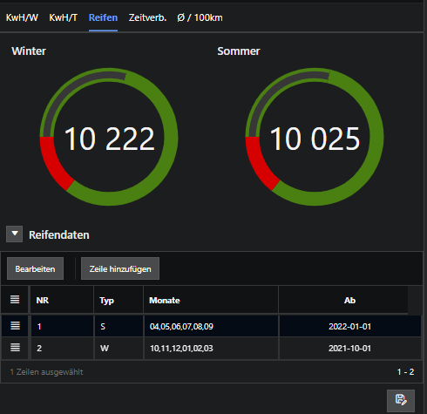
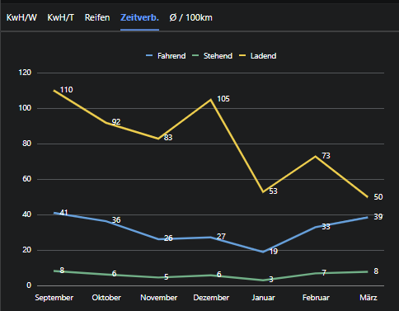
3
Wordpress Theme vs. APEX Universal Theme
Statistiken

Slide 19
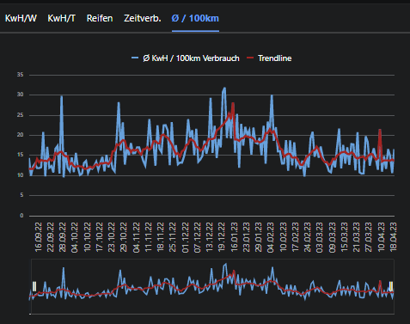
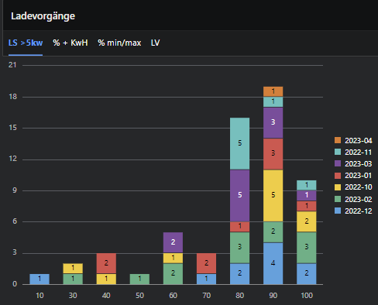
3
Wordpress Theme vs. APEX Universal Theme
Statistiken

Slide 20
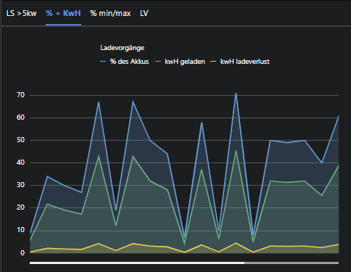
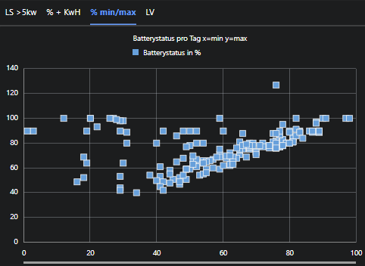
3
Wordpress Theme vs. APEX Universal Theme
Statistiken

Slide 21
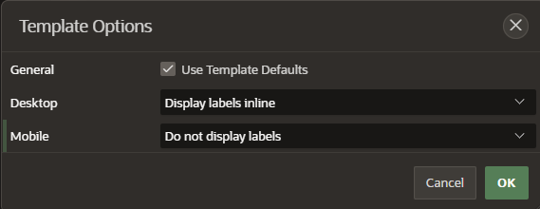
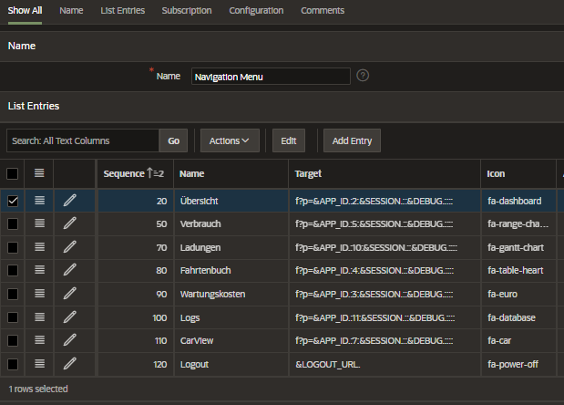
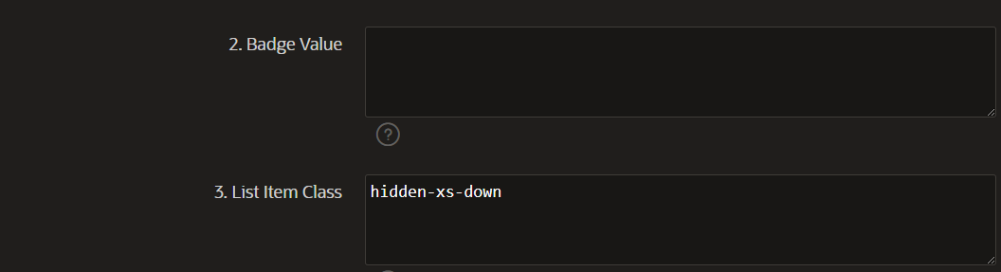
3
Wordpress Theme vs. APEX Universal Theme
The Menü
Damit blendet man Listentries auf kleinen Bildschirmen aus

Slide 22
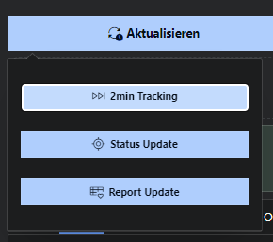
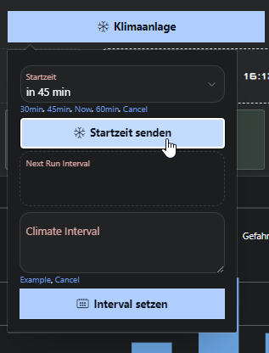
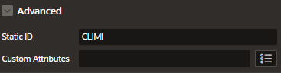
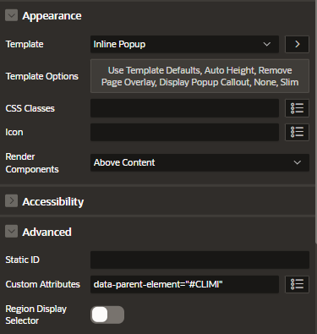
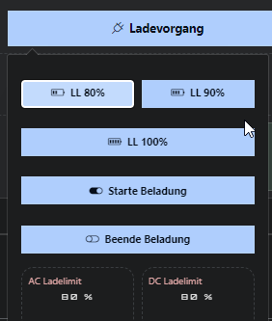
3
Wordpress Theme vs. APEX Universal Theme
Remote Control + Inline Popup Configuration

Slide 23
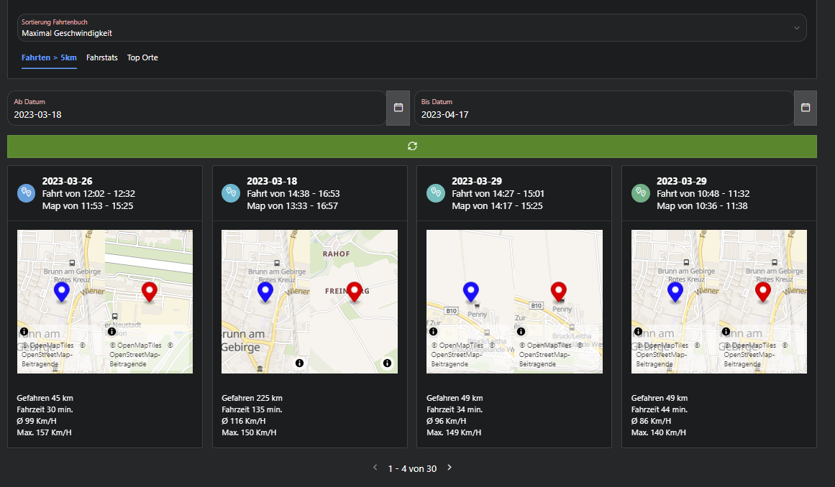
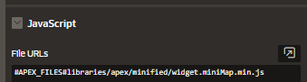
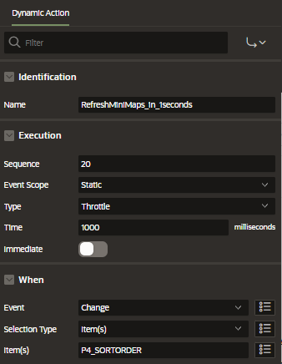
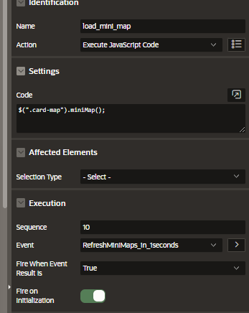
3
Wordpress Theme vs. APEX Universal Theme
Mini Maps im Fahrtenbuch
Maps Regions nicht mit Card Region kombinierbar daher => Lösung mini Maps in den Cards

Slide 24
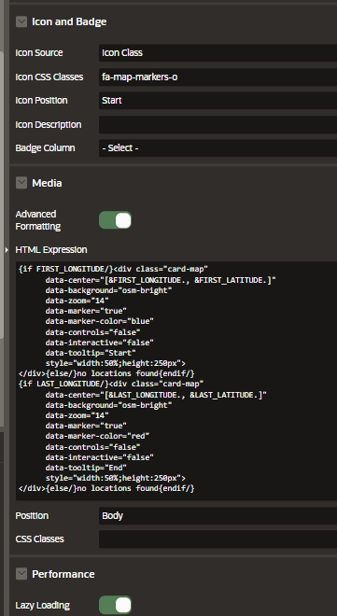
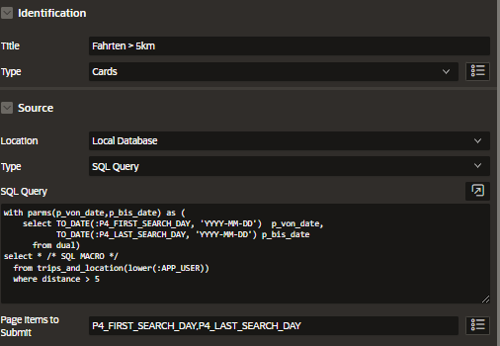
3
Wordpress Theme vs. APEX Universal Theme
Mini Maps im Fahrtenbuch
SQL Macros used in Oracle Apex (hashnode.dev)

Slide 25

3
Wordpress Theme vs. APEX Universal Theme
Fahrtenbuch

Slide 26

3
Wordpress Theme vs. APEX Universal Theme
Fahrtenbuch

Slide 27

3
Wordpress Theme vs. APEX Universal Theme
Fahrtenbuch

Slide 28
3
JSON_TABLE Car Status
JSON_TABLE (json_data, '$'
columns (
time NUMBER PATH '$.time',
batstatus12v NUMBER PATH '$.battery.batSoc',
tirePressureLampAll NUMBER PATH '$.tirePressureLamp.tirePressureLampAll',
climate varchar2 PATH '$.airCtrlOn',
frunkopen varchar2 PATH '$.hoodOpen',
trunkOpen varchar2 PATH '$.trunkOpen',
doorlock varchar2 PATH '$.doorLock',
NESTED PATH '$.evStatus[*]'
columns ( batterycharge varchar2 PATH '$.batteryCharge',
batterystatus NUMBER PATH '$.batteryStatus',
plugin NUMBER PATH '$.batteryPlugin',
remaintime NUMBER PATH '$.remainTime2.atc.value',
evModeRange NUMBER PATH '$.drvDistance.rangeByFuel.evModeRange.value'
)
)
) jt
where e.json_type = 'STATUS'

Slide 29
3
JSON_TABLE Drivehistory (Tagesverbrauch)
JSON_TABLE ( json_data, '$'
COLUMNS (
NESTED PATH '$.history[*]'
COLUMNS (
datetime NUMBER PATH '$.rawDate',
distance NUMBER PATH '$.distance',
regeneration NUMBER PATH '$.regen',
NESTED PATH '$.consumption[*]'
COLUMNS (
total NUMBER PATH '$.total',
engine NUMBER PATH '$.engine'
)
)
)
)
jt
WHERE
e.json_type = 'DRIVEHISTORY'

Slide 30
3
JSON_TABLE Trips (Einzelfahrten)
JSON_TABLE ( e.json_data, '$'
COLUMNS (
NESTED PATH '$.trips[*]'
COLUMNS (
tripstart varchar PATH '$.start',
tripend varchar PATH '$.end',
distance varchar PATH '$.distance',
drivetime NUMBER PATH '$.durations.drive',
idletime NUMBER PATH '$.durations.idle',
speedavg NUMBER PATH '$.speed.avg',
speedmax NUMBER PATH '$.speed.max'
)
)
)
jt
WHERE
e.json_type = 'TRIPINFO'

Slide 31
3
JSON_TABLE Monatsreport (eigentlich Drivehistory aggregiert)
JSON_TABLE (json_data, '$'
columns (
started NUMBER PATH '$.start',
ended PATH '$.end',
NESTED PATH '$.driving[*]'
COLUMNS (
distance NUMBER PATH '$.distance',
NESTED PATH '$.durations[*]'
columns ( duration_drive NUMBER PATH '$.drive',
duration_idle number path '$.idle')
)
)) jt
where e.json_type = 'MONTHLYREPORT'

Slide 32

3
Datenmodell Locationtracking

Slide 33

3
Datenmodell

Slide 34
3
Oracle VPD aktivieren
CREATE OR REPLACE FUNCTION get_tenant_predicate (object_schema IN VARCHAR2, object_name VARCHAR2)
return varchar2 DETERMINISTIC as
l_predicate varchar2(4000);
begin
-- Only apply VPD to specific APEX applications
if sys_context('APEX$SESSION', 'APP_ID') in (100)
then
l_predicate:= q'#( appusername =
coalesce(lower(sys_context('APEX$SESSION', 'APP_USER')),
sys_context('ACT_AS_APEX', 'APP_USER’)
)#';
end if;
return l_predicate;
end get_tenant_predicate;
BEGIN
DBMS_RLS.ADD_POLICY(object_schema => 'MYSCHEMA',
object_name => 'CARLOG_DATA',
policy_name => 'CARLOGUSERS',
policy_function => ‘get_tenant_predicate',
statement_types => 'SELECT');
END;
/

Slide 35
6
Pains und Learning
My first Carlogbook Registration (hashnode.dev)
Troubles to get Multiuser Ready (hashnode.dev)
CarLogBook Monitoring (hashnode.dev)
Good old Oracle 21c is dying (hashnode.dev)
Notes:
Mailchimp für Newsletter, Wordpress nicht mehr anpassbar (custom theme), Look and Feel innerhalb einer Applikation besser gestaltbar.

Slide 36
9
Die besten Ressourcen um mit der Oracle Cloud zu starten
Dimitri Gielis Blog Free Tier - Step by Step Guide
ORACLE-BASE Let‘s Encrypt – Free Certificates on Oracle Linux (dimitri‘s encrypt hat bei mir nicht geklappt)
How to Update All Packages in Oracle Linux 8 (linuxhint.com) Damits nicht ungesagt bleibt..
How to Connect to Oracle Cloud Free Tier Database using SQL Developer | by Vivek Kumar (Vik) | oracle-saas-paas | Medium kein Must-have
https://content.dsp.co.uk/apex/can-i-generate-pdfs-from-apex-in-the-always-free-oracle-cloud Generate PDFS on Free-Tier for Free
capturing-lat-long-address-info-without-a-map Get Geolocation without Apex Map Feature
load-data-into-existing-tables-with-apex-191 Good to know
APEX Map Region vs. Google Map Plugin | Jeff Kemp on Oracle Apex Map Region, reicht uns vollkommen aus… aber Google Maps sind halt schon sehr gut
A Simple Guide to the New Cards Region in APEX 20.2 (oracle.com) Cards, Cards, Cards
Dimitri Gielis Blog (Oracle Application Express - APEX): More Advanced File Uploads in Oracle APEX (dgielis.blogspot.com) Use the ObjectStore Luke
Sample Cards - Embedded Video (oracle.com) Cards mit Videos
Manage Countries Coordinates and Flags in Database using RESTful Web Services and PLSQL (orclking.blogspot.com) War mal eine Überlegung
(1) Top 10 tips to optimize APEX for mobile - Vincent Morneau – YouTube PWA und alles was man darüber Wissen sollte!
Apex 21.1 Map region. How to center and zoom to a specific location? — oracle-tech How to center and zoom to a specific location in Apex Map Region
How to get Screen Resolution of system in Oracle Apex – Explore the world of amazing APEX (apexexplorer.com) Responsive Web App
About Oracle: Creating a mobile app with APEX - Part 11: Displaying form items side by side (dickdral.blogspot.com) Kann helfen! CSS related
Display BLOB Contents (PDF, Images) into a Region in Oracle Apex Page - foxinfotech.in Nicht jedes Formular kommt in die Datenbank – Paper rulez
Fast nearest-location finder (store finder) for Oracle (plumislandmedia.net) Wichtige Function um Luftlinie in PL/SQL zu berechnen
Next/Previous Record: how APEX does it | Jeff Kemp on Oracle Warum ich da nicht selbst drauf gekommen bin?
(1) Upload Files to Object Storage from Oracle Application Express (APEX) – YouTube Todo – Blob to Objectstore Switch
https://blog.cloudnueva.com/apex-automations Apex Automations (Emails, Backup, .. z.b.)
9.1
Die besten Ressourcen für Apex

Slide 37
Zeitverlauf
Email Notifications
April/2023
New Ideas
2023/2024
Multiuser
JAN/2023
Push Notification
Apex 23.1 ? /2023
Monitoring
Feb/2023
First Version
NOV/2022
Infrastructur
OCT/2022

Slide 38

?
!
!
!
!
!
!
Ing. Thomas Lieber
E thomas.lieber@sphinx.at
M 0664/5183529
T +43 1 599 31-0
……………………….
sphinx
Aspernbrückengasse 2
1020 Wien
……………………….
www.sphinx.at
!

